Slide 1

Housing Market Sale-price Predictor
(HoMS Predictor)
Presentation and work by Stephen Dodd

Slide 2


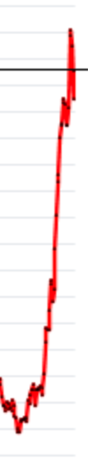
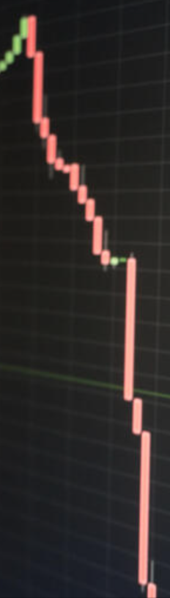
What’s wrong with the housing market?!
Home prices have been all over the place in recent years. Just look at the average home price in a few selected years:
1985 - $82,800
April, 2008 - $314,300
January, 2009 - $245,200
June, 2019 - $361,900
April, 2022 - $569,300

Slide 3
What factors affect home sale price?
Factors our model does address and predict for:
Square Footage (total, ground floor and basement)
Garage size by vehicle capacity
Overall quality of a home
Home age
Presence of a pool
Factors our model doesn’t address directly, but nonetheless account for:
Interest rates are a big factor affecting home prices.
Economic boom and bust cycles.
Location and migration
Factors affecting home price that our model cannot account for:
The cost and/or value of renovations
Unique features, such as unusual architecture or features

Slide 4
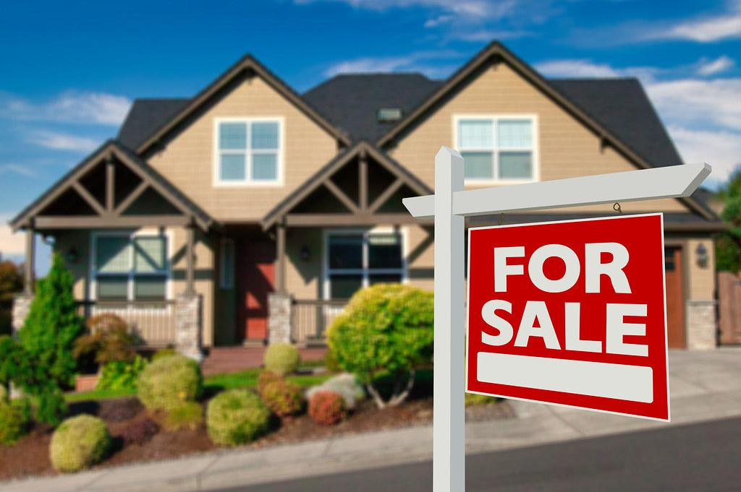
Who should use the HoMS Predictor?
* Home buyers and sellers should use this tool with their realtor to improve comps and ensure both parties get a fair deal.
** Sellers might also use this tool to make profitable upgrades.
*** Buyers might use this tool to compare homes to find the best value.

Slide 5
A word of caution…
This model was created for a particular set of test data, and may not translate to your local housing market. The sales prices and data used is from a test set for a Kaggle challenge, and may or may not even be real data. Feel free to play with the model, but don’t take it’s predictions as truth, as it is not built from the conditions of your particular housing market.
Example for context:
Two identical homes in California and Kansas, on similar sized plots, in similar sized cities, with similar demographics, will not sell for even close to approximately the same sale price. This model will over or undervalue, based on the particular market conditions of your housing market, and there isn’t a good way to know which.

Slide 6
Variables
Teasing out the most appropriate variables was a long process, as you will see in the Data Wrangling and Exploratory Data Analysis sections of the project.
We began with 81 columns, and selected 8, excluding our target variable and id:
Target variable:
SalePrice
Final selections were: MSSubClass, OverallQual, TotalBsmtSF, GrLivArea, GarageCars, TotalSF, HasPool

Slide 7
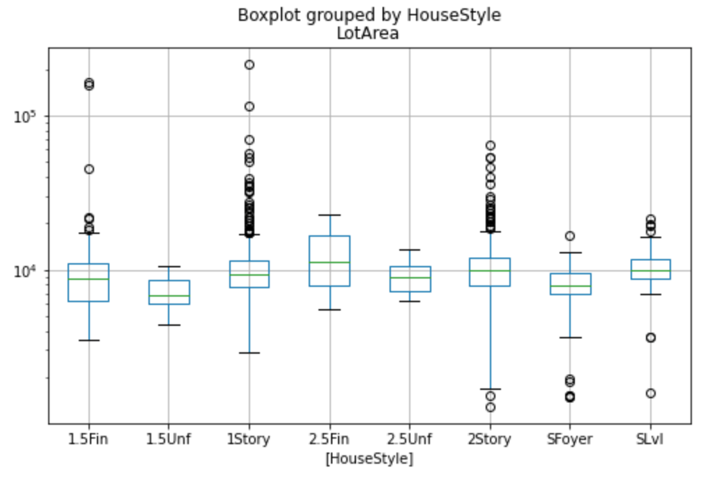
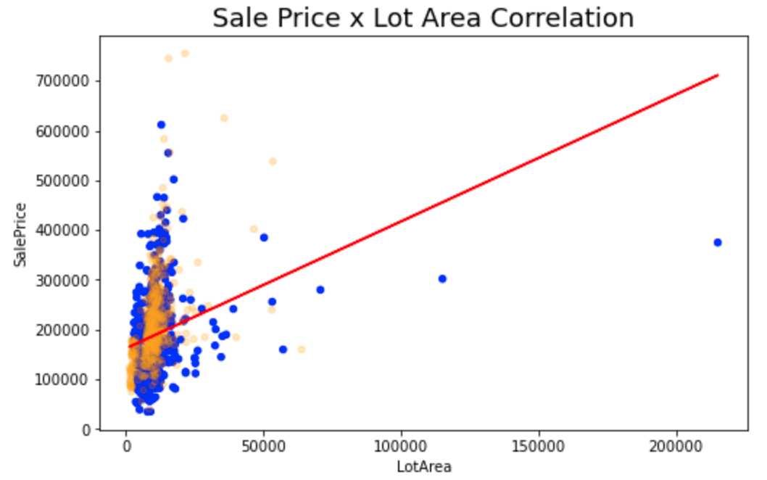
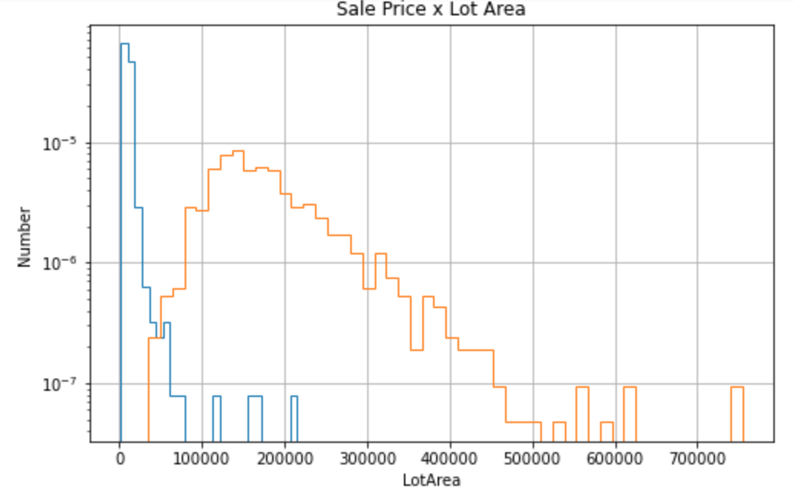
Data Wrangling
Data wrangling began with looking into all columns of the DataFrame and examining columns that personal experience would suggest to be large factors. This served the purpose of both to familiarizing myself with the data and determining whether to carry those columns forward. I didn’t want to quickly eliminate those columns that I believed would be useful without examining them closely. I used histograms to look at distributions and scatterplots and linear regressions, and used p-values and correlation coefficients to make this determination.

Slide 8
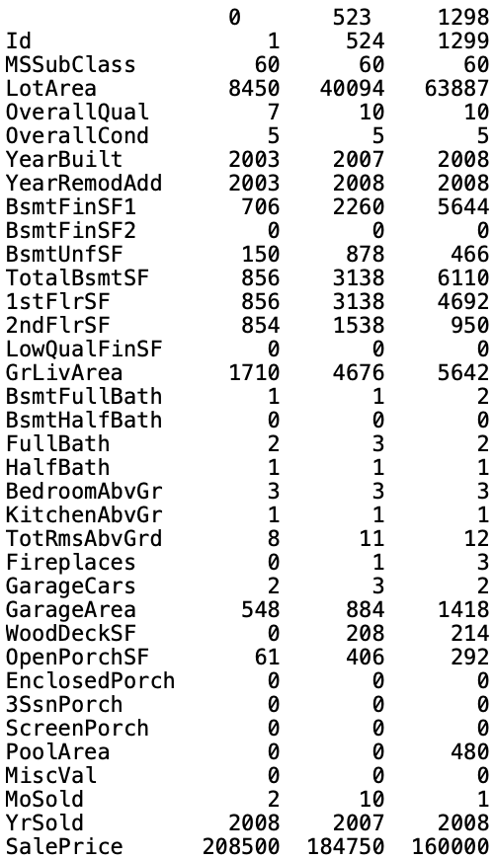
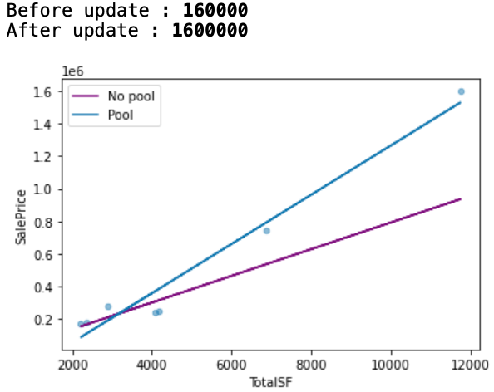
Exploratory Data Analysis
A focus on outliers and interdimensional relationships.

Slide 9
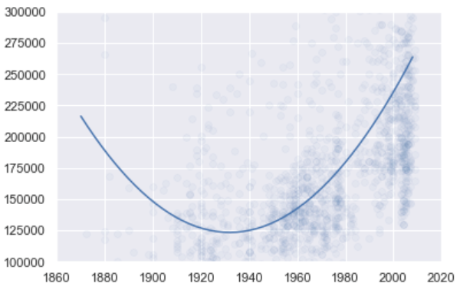
Exploratory Data Analysis, cont’d
Beyond Linear regression
In my exploration, I found that some trends were not best fit to linear regression models. For example, year of construction in the chart at right had a positive correlation to sale price, except for homes built prior to 1930, homes built before that time had a negative correlation of year of construction and sale price. And this column, year of construction was one of the variables that we ultimately chose to build this model, based on a linear regression.

Slide 10
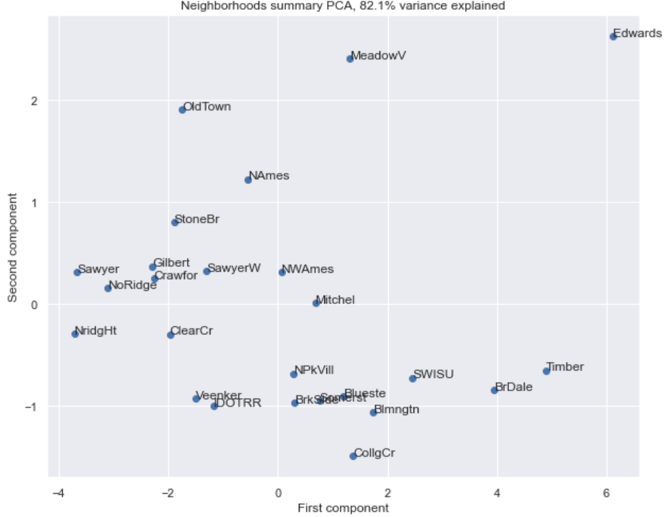
EDA - PCA
PCA analysis by neighborhood averages shows a pretty strong explanation of variance, with the first two components explaining over 80% of the variance. Mean was used to group the values for component analysis.

Slide 11
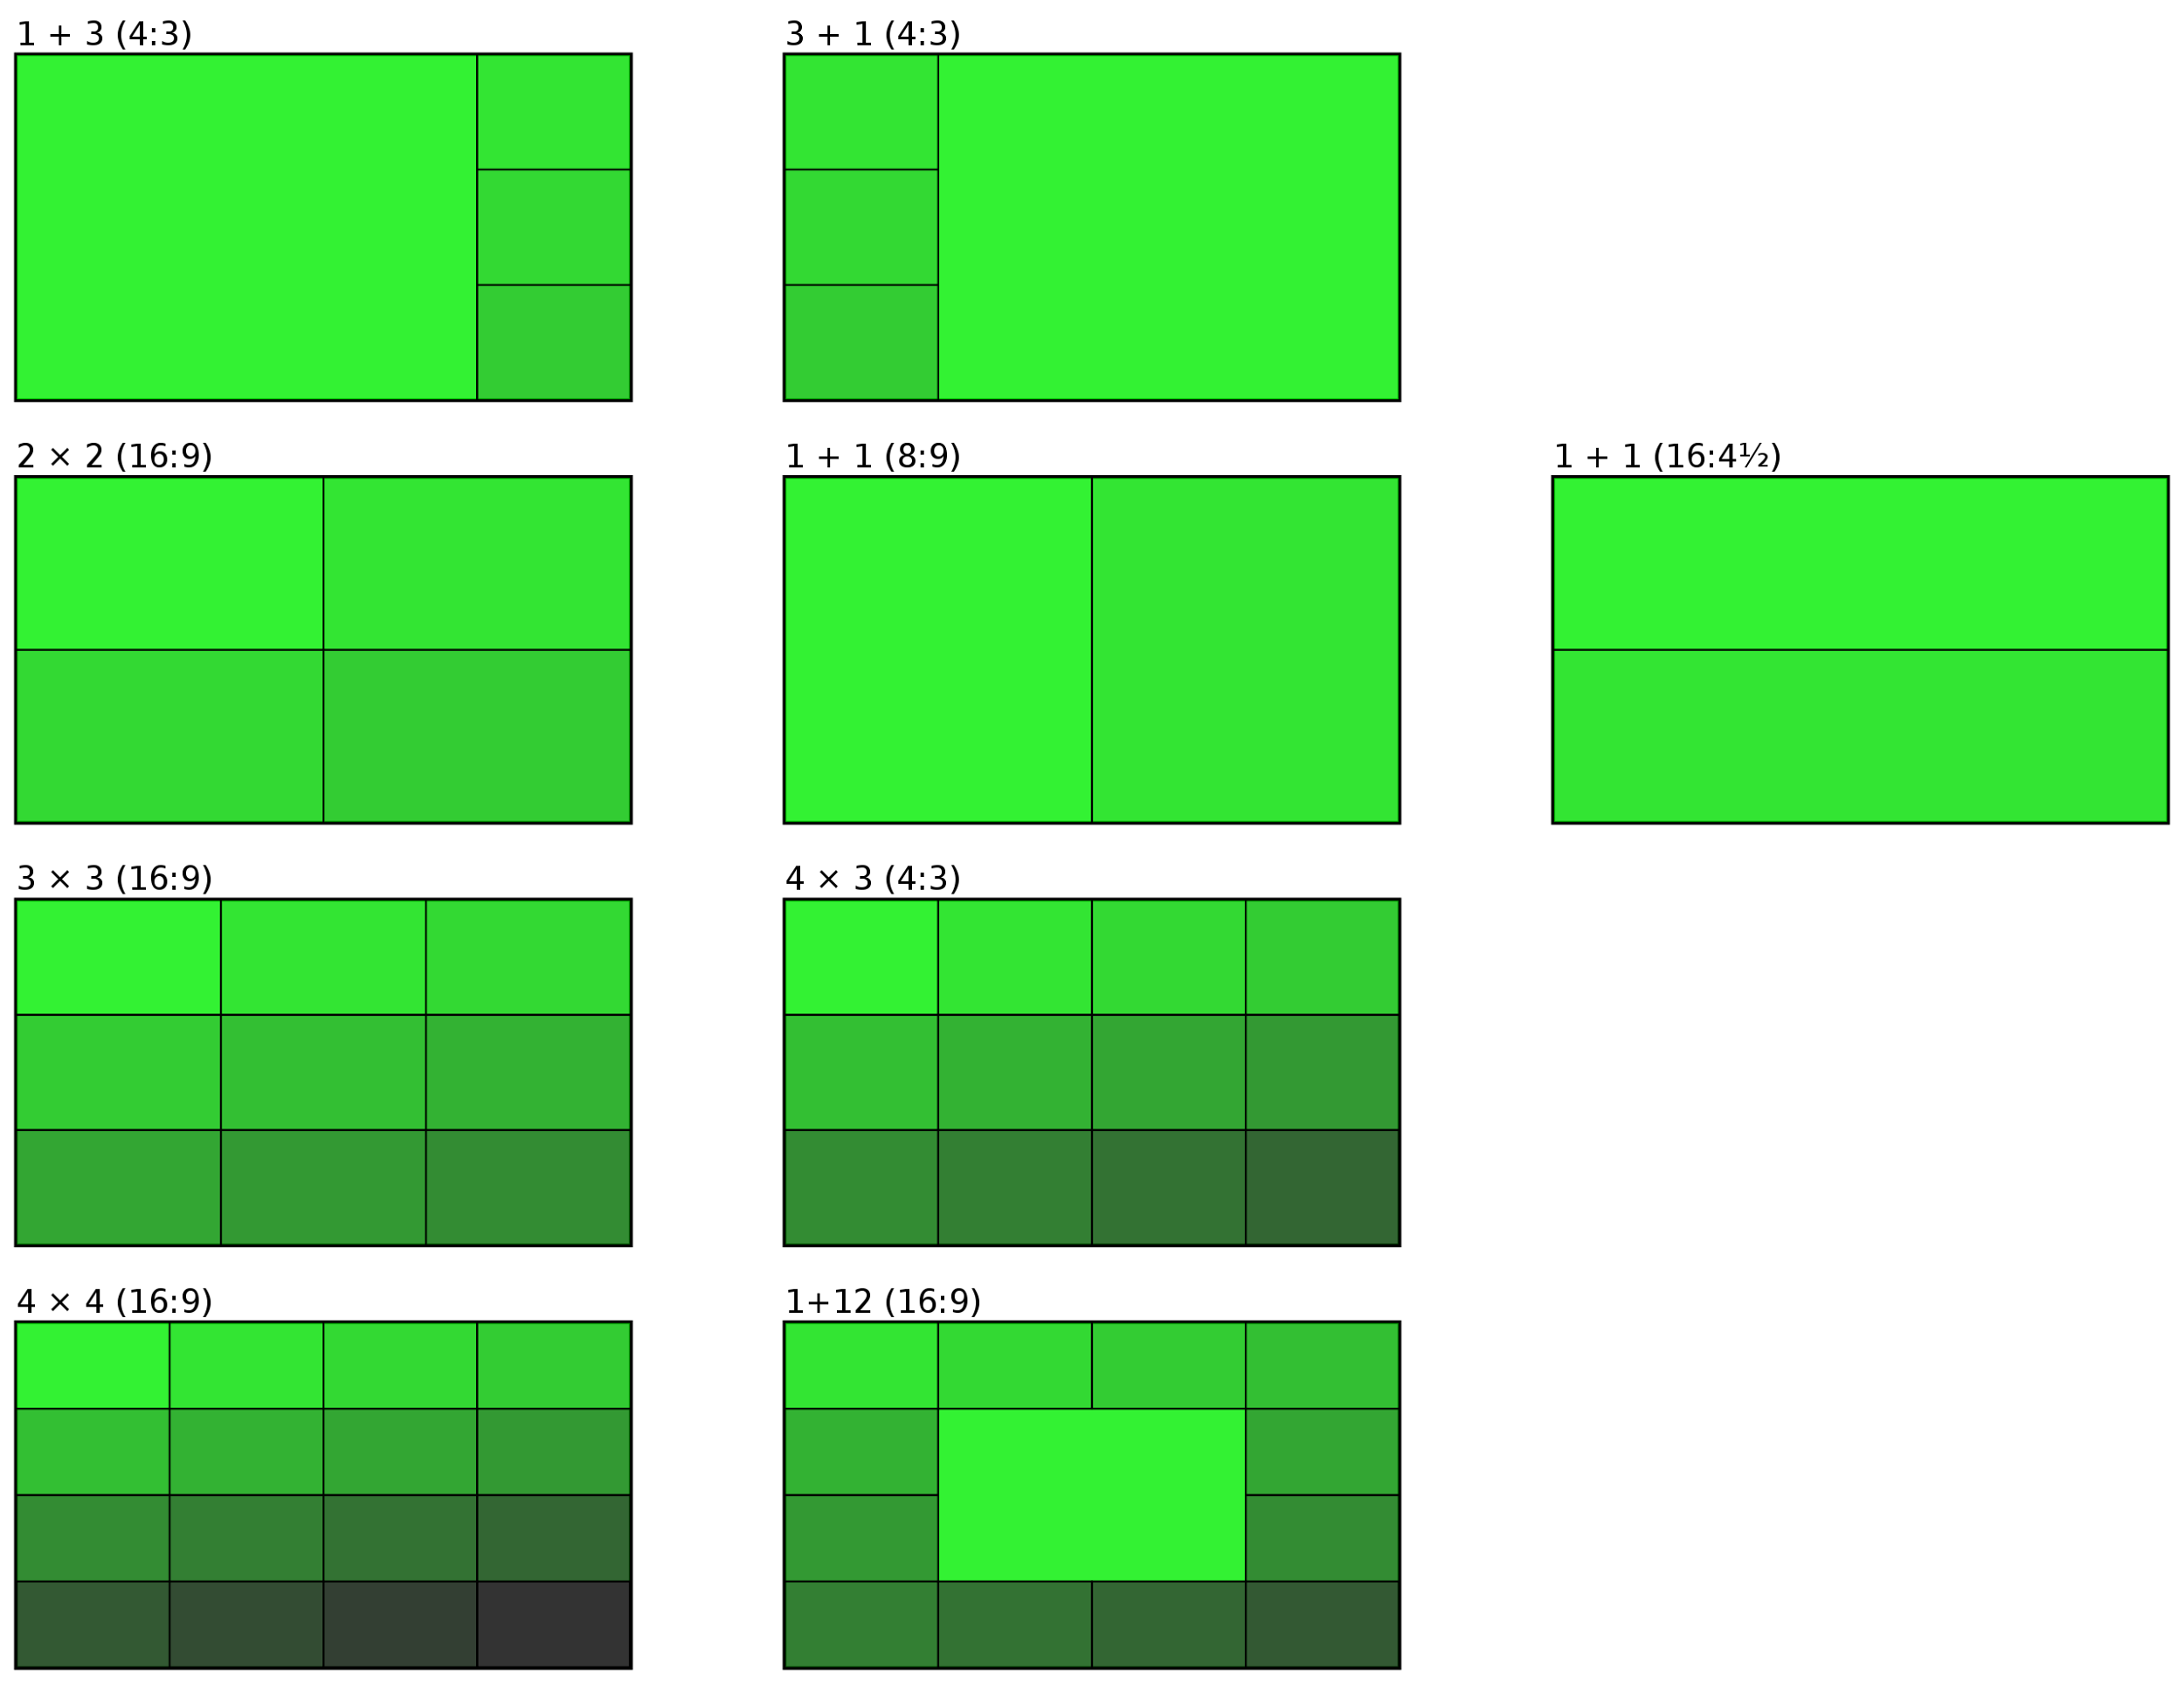

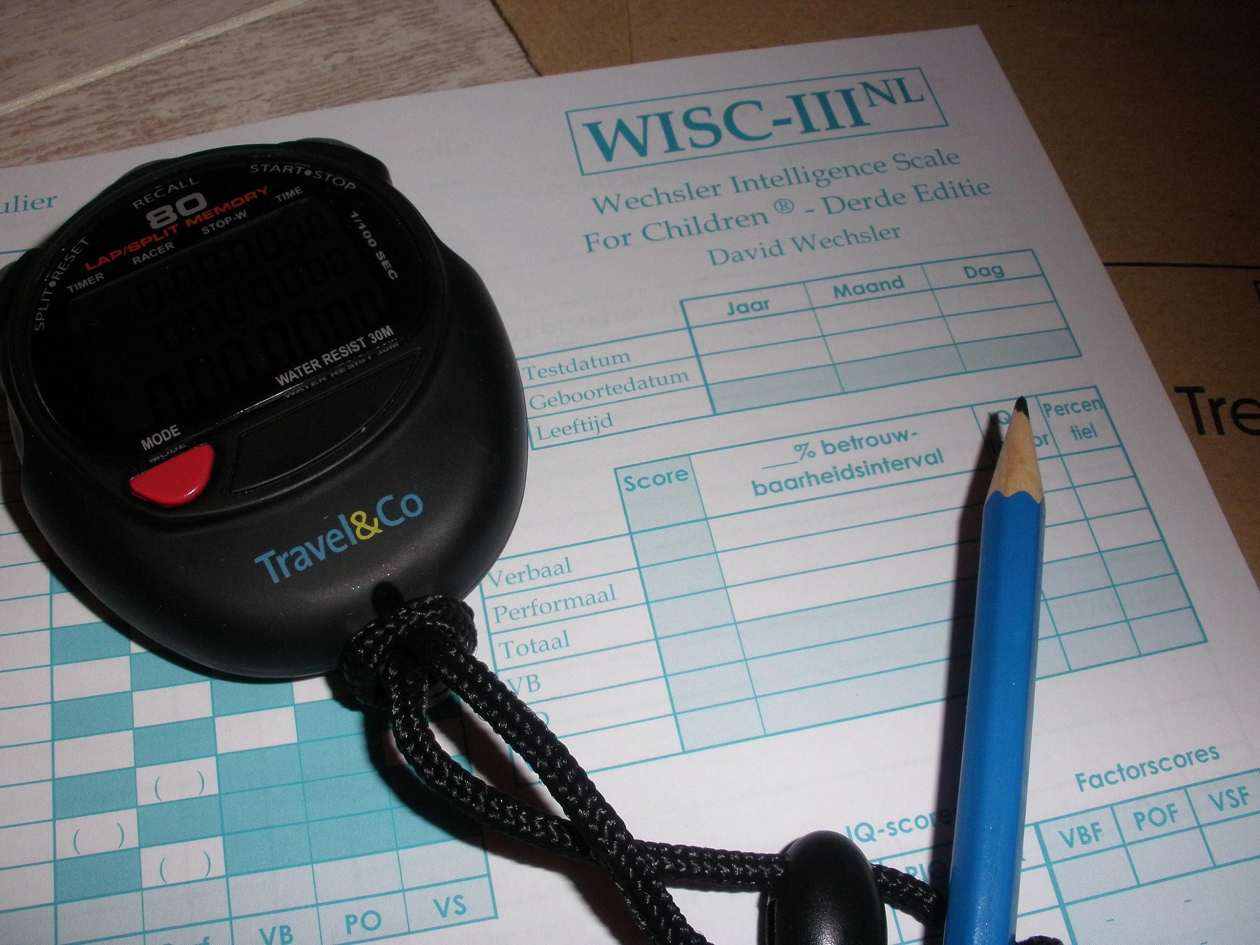
Data Pre-processing
The first data transformation was to get dummy variables.
The second was to run a train test split of 80/20.
The final step was to scale my data.
sklearn.preprocessing.StandardScaler
pd.get_dummies
sklearn.model_selection.train_test_split

Slide 12
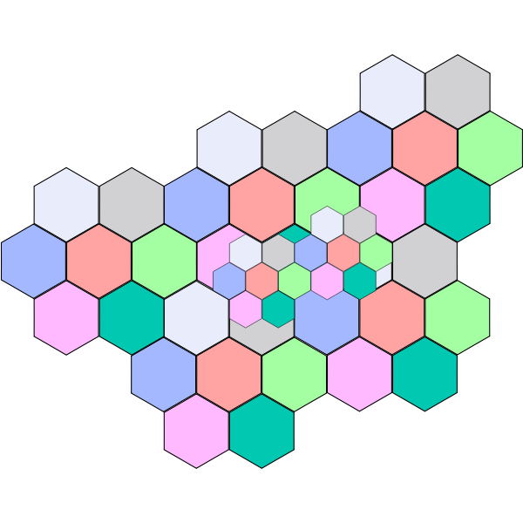
Model Selection
The model selection was somewhat simple in this case. A realtor would pull sales data from a few similar homes to determine a good prices. As such, it seems that this problem was best suited to clustering, despite the overwhelming use of regression in Data Wrangling and EDA. The former was a good means of determining which variables would be best used for clustering.
-The models selected were Support Vector Machine, Gaussian Naive Bayes and Random Forest.

Slide 13
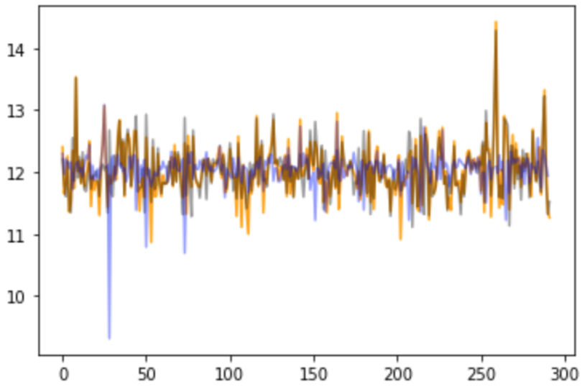
Model Performance
RandomForest predictions vs actuals vs residuals
Orange: predictions, black: actual, blue: residuals
-The outliers that I kept due to their goodness of fit on a linear regression did have an impact on my outcome, and I wondered if I would have been better off removing them.
-The GNB model performed quite poorly, most likely due to the number of variables, so for it’s purposes, I removed all but the two most strongly correlated variables. Still, it was the poorest performing model.
-The RandomForest model was a clear winner, with an r-squared score on unseen test data of .7. In my opinion this was quite phenomenal.

Slide 14
Conclusion
A few outliers aside, home values can be accurately predicted, given the appropriate data. This model does a good job predicting home values with clustering models, however ensemble regression models such as GradientBoostingRegression may have also been appropriate.
Thank you for taking the time to view my work,
I hope you’ve enjoyed it!

Slide 15
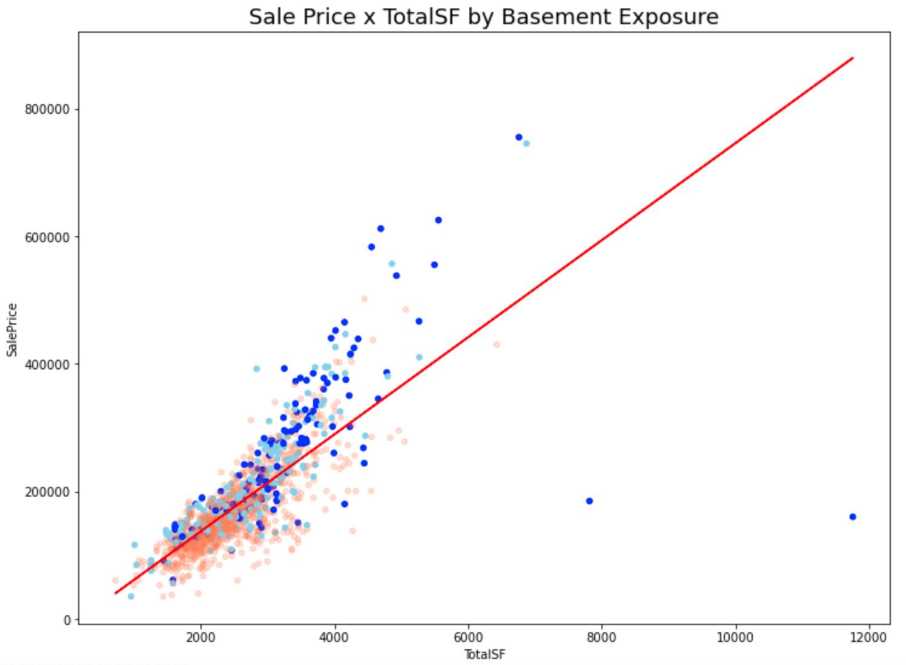
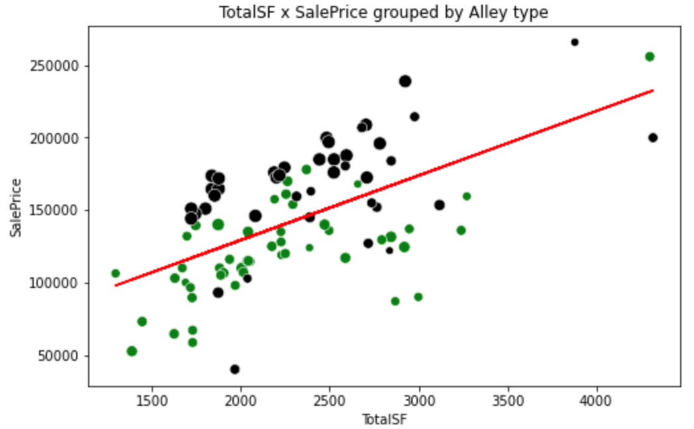
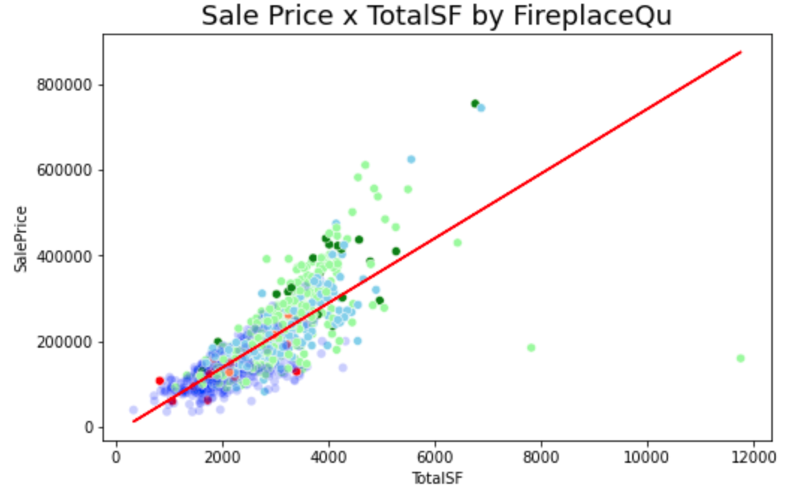
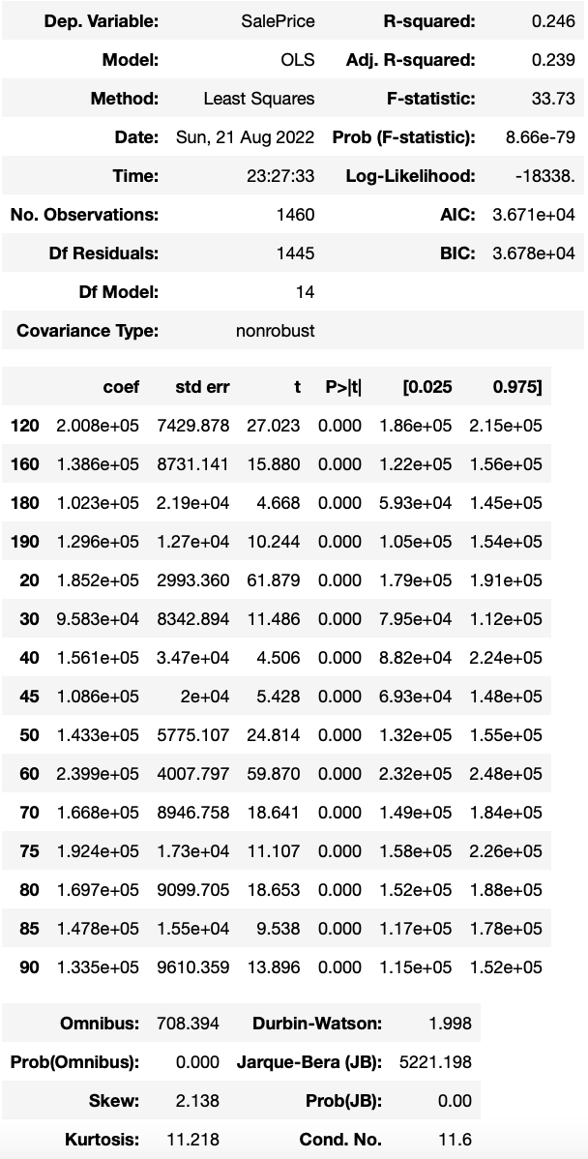
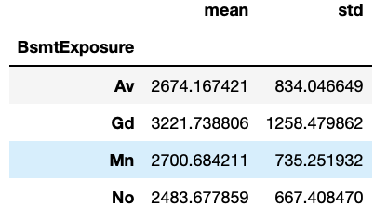
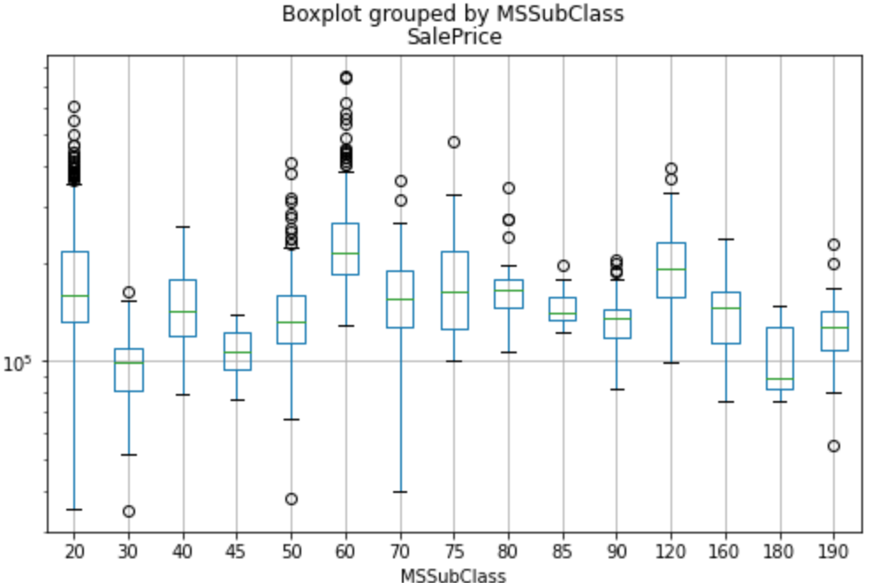
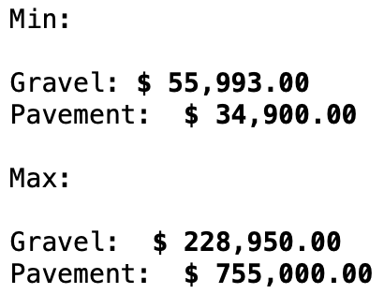
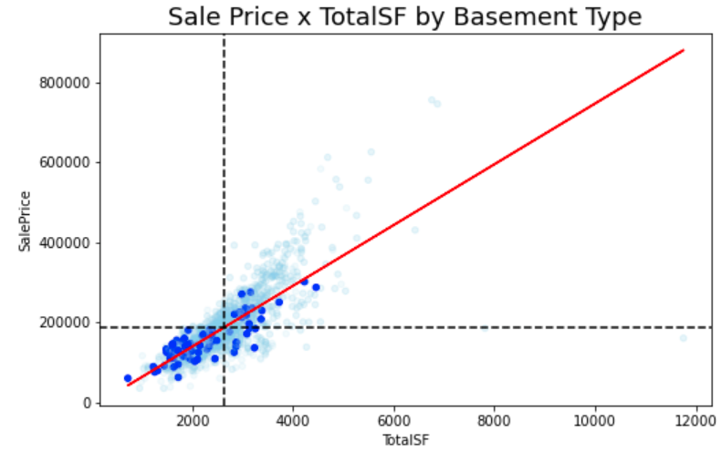
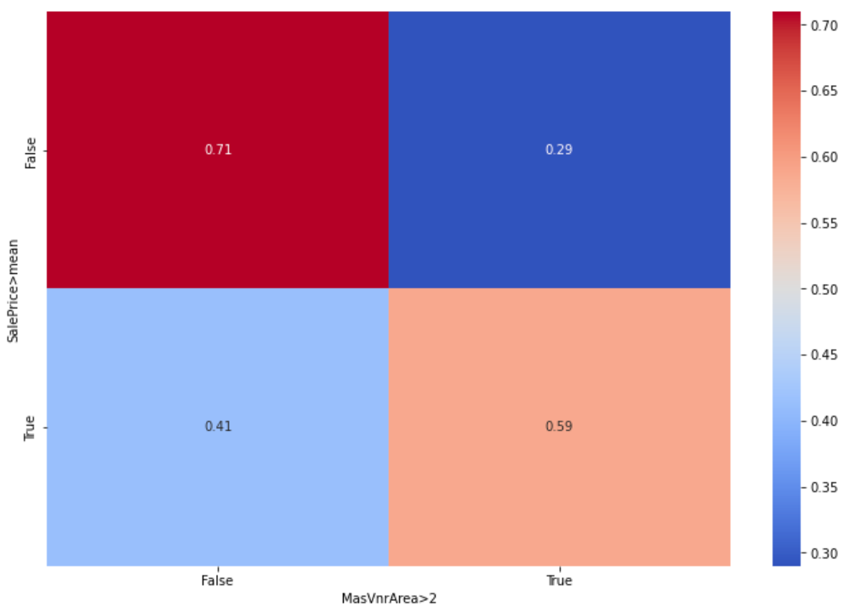
Random EDA

